Slide 1
Classification
Ensemble Classifiers

Slide 2
Examples of Ensemble Methods
How to generate an ensemble of classifiers?
Bagging
Boosting
Random Forests

Slide 3
Bagging
Also known as bootstrap aggregation
Sampling uniformly with replacement
Build classifier on each bootstrap sample
0.632 bootstrap
Each bootstrap sample D_{i} contains approx. 63.2% of the original training data
Remaining (36.8%) are used as test set
Example taken from Tan et. al. book “Introduction to Data Mining”

Slide 5
Bagging: Boostrap Aggregation
Analogy: Diagnosis based on multiple doctors’ majority vote
Training
Given a set D of d tuples, at each iteration i, a training set D_{i} of d tuples is sampled with replacement from D (i.e., boostrap)
A classifier model M_{i} is learned for each training set D_{i}
Classification: classify an unknown sample X
Each classifier M_{i} returns its class prediction
The bagged classifier M* counts the votes and assigns the class with the most votes to X
Prediction: can be applied to the prediction of continuous values by taking the average value of each prediction for a given test tuple
Accuracy
Often significant better than a single classifier derived from D
For noise data: not considerably worse, more robust
Proved improved accuracy in prediction

Slide 6
Bagging
Accuracy of bagging:
Works well for small data sets
Example:
X | 0.1 | 0.2 | 0.3 | 0.4 | 0.5 | 0.6 | 0.7 | 0.8 | 0.9 | 1.0
y | 1 | 1 | 1 | -1 | -1 | -1 | -1 | 1 | 1 | 1
Actual Class labels
Example taken from Tan et. al. book “Introduction to Data Mining”

Slide 7
Bagging
Decision Stump
Single level decision binary tree
Entropy – x<=0.35 or x<=0.75
Accuracy at most 70%
Actual Class labels

Slide 8
Bagging
Accuracy of ensemble classifier: 100% ☺
Example taken from Tan et. al. book “Introduction to Data Mining”

Slide 9
Bagging- Final Points
Works well if the base classifiers are unstable
Increased accuracy because it reduces the variance of the individual classifier
Does not focus on any particular instance of the training data
Therefore, less susceptible to model over-fitting when applied to noisy data
What if we want to focus on a particular instances of training data?

Slide 10
Boosting
An iterative procedure to adaptively change distribution of training data by focusing more on previously misclassified records
Initially, all N records are assigned equal weights
Unlike bagging, weights may change at the end of a boosting round

Slide 11
Boosting: Motivation
Hard to design accurate classifier which generalizes well
• Easy to find many rule of thumb or weak classifiers
• a classifier is weak if it is slightly better than random guessing
• example: if an email has word “money” classify it as spam,
otherwise classify it as not spam
• likely to be better than random guessing
• Can we combine several weak classifiers to produce an
accurate classifier?
• Ada‐Boost (1996) was the first practical boosting algorithm

Slide 12
Boosting
Records that are wrongly classified will have their weights increased
Records that are classified correctly will have their weights decreased
Example 4 is hard to classify
Its weight is increased, therefore it is more likely to be chosen again in subsequent rounds
Example taken from Tan et. al. book “Introduction to Data Mining”

Slide 13
Boosting
Equal weights are assigned to each training tuple (1/d for round 1)
After a classifier M_{i} is learned, the weights are adjusted to allow the subsequent classifier M_{i+1} to “pay more attention” to tuples that were misclassified by M_{i}.
Final boosted classifier M* combines the votes of each individual classifier
Weight of each classifier’s vote is a function of its accuracy
Adaboost – popular boosting algorithm

Slide 14
Adaboost
Input:
Training set D containing d tuples
k rounds
A classification learning scheme
Output:
A composite model

Slide 15
Adaboost
Data set D containing d class-labeled tuples (X1,y1), (X2,y2), (X3,y3),….(Xd,yd)
Initially assign equal weight 1/d to each tuple
To generate k base classifiers, we need k rounds or iterations
Round i, tuples from D are sampled with replacement , to form D_{i} (size d)
Each tuple’s chance of being selected depends on its weight

Slide 16
Adaboost
Base classifier M_{i}, is derived from training tuples of D_{i}
Error of M_{i} is tested using D_{i}
Weights of training tuples are adjusted depending on how they were classified
Correctly classified: Decrease weight
Incorrectly classified: Increase weight
Weight of a tuple indicates how hard it is to classify it (directly proportional)

Slide 17
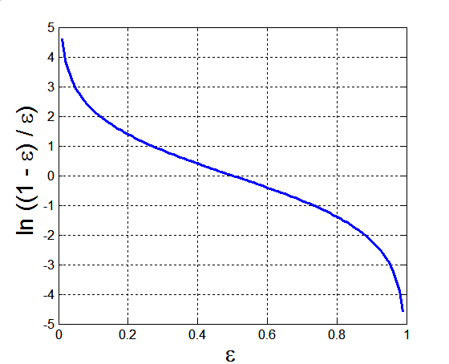
Example: AdaBoost
Base classifiers: C₁, C₂, …, C_{T}
Error rate:
Importance of a classifier:

Slide 18
Example: AdaBoost
Weight update:
If any intermediate rounds produce error rate higher than 50%, the weights are reverted back to 1/n and the re-sampling procedure is repeated

Slide 19
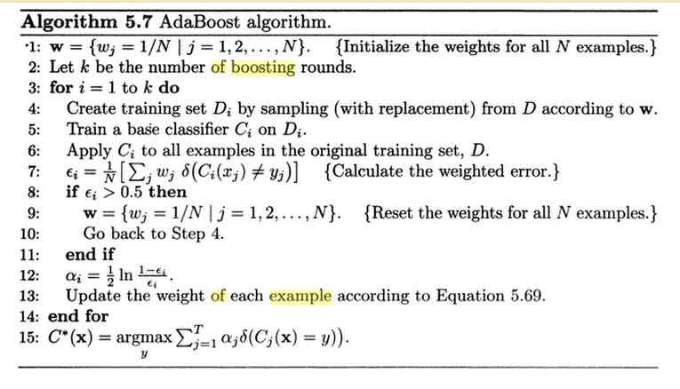

Slide 20
Illustrating AdaBoost
Initial weights for each data point
Data points for training

Slide 21
Illustrating AdaBoost

Slide 22
Example:
X | 0.1 | 0.2 | 0.3 | 0.4 | 0.5 | 0.6 | 0.7 | 0.8 | 0.9 | 1.0
y | 1 | 1 | 1 | -1 | -1 | -1 | -1 | 1 | 1 | 1
Actual Class labels
Example taken from Tan et. al. book “Introduction to Data Mining”

Slide 23
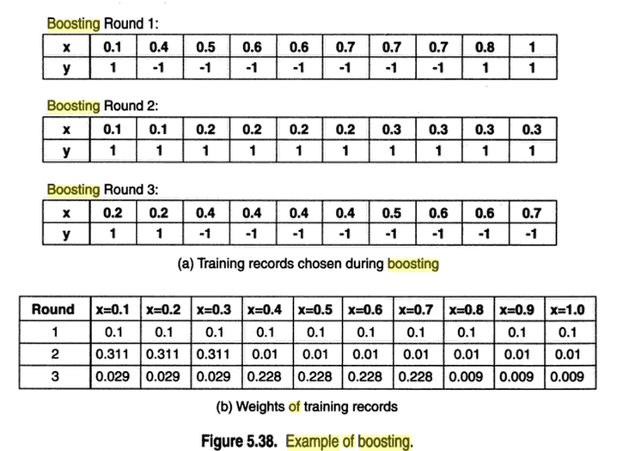

Slide 24
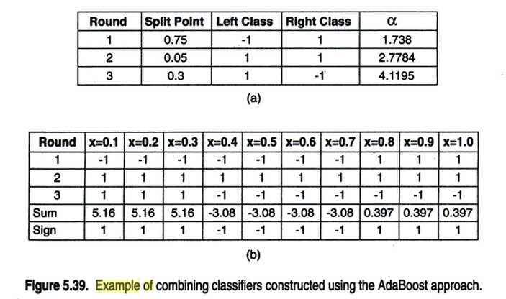

Slide 25
Random Forests
Ensemble method specifically designed for decision tree classifiers
Random Forests grows many classification trees (that is why the name!)
Combines predictions made by many decision trees.
Each tree is generated based on a bootstrap sample and the values of an independent set of random vectors.
The random vectors are generated from a fixed probability distribution.
Ensemble of unpruned decision trees
Each base classifier classifies a “new” vector
Forest chooses the classification having the most votes (over all the trees in the forest)

Slide 26
Random Forests
Introduce two sources of randomness: “Bagging” and “Random input vectors”
Each tree is grown using a bootstrap sample of training data
At each node, best split is chosen from random sample of m_{try} variables instead of all variables

Slide 27
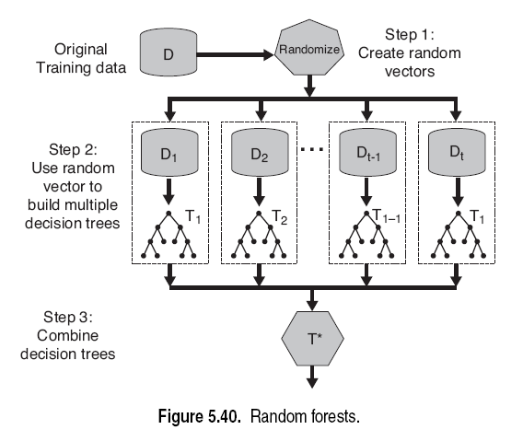
Random Forests

Slide 28
Randomizing Random Forests
Each decision tree uses a random vector that is generated from some fixed probability distribution. This randomness can be incorporated in many ways:
Randomly select F input features to split at each node (Forest-RI).
2. Create linear combinations of the input features to split at each node (Forest-RC).
3. Randomly select one of the F best splits at each node.

Slide 29
Why use Random Vectors?
Recall that an underlying assumption of the ensemble process is that the base learners are independent.
As the trees become more correlated (less independent), the generalization error bound tends to increase.
Randomization helps to reduce the correlation among decision trees.

Slide 30
Random Forests Error Bounds
The upper bound for generalization error of random forests converges to the following expression, when the number of trees is sufficiently large

Slide 31
Using Random Features
Random split selection does better than bagging; introduction of random noise into the outputs also does better.
To improve accuracy, the randomness injected has to minimize the correlation$ρ$ while maintaining strength.

Slide 32
Random Forest Algorithm
M input variables, a number m<<M is specified such that at each node, m variables are selected at random out of the M and the best split on these m is used to split the node.
m is held constant during the forest growing
Each tree is grown to the largest extent possible
There is no pruning
Bagging using decision trees is a special case of random forests when
m=M

Slide 33
Random Forest Algorithm
Out-of-bag (OOB) error
Good accuracy without over-fitting
Fast algorithm (can be faster than growing/pruning a single tree); easily parallelized
Handle high dimensional data without much problem
Only one tuning parameter m_{try} = , usually not sensitive to it

Slide 34
Out of Bag Error

Slide 35
Features and Advantages
The advantages of random forest are:
It is one of the most accurate learning algorithms available. For many data sets, it produces a highly accurate classifier.
It runs efficiently on large databases.
Simple and easily parallelized.
It can handle thousands of input variables without variable deletion.
It gives estimates of what variables are important in the classification.
It generates an internal unbiased estimate of the generalization error as the forest building progresses.
It has an effective method for estimating missing data and maintains accuracy when a large proportion of the data are missing.

Slide 36
Disadvantages
Random forests have been observed to overfit for some datasets with noisy classification/regression tasks.
For data including categorical variables with different number of levels, random forests are biased in favor of those attributes with more levels. Therefore, the variable importance scores from random forest are not reliable for this type of data.

